Slide 1
IT Security and Penetration Testing
Chapter 8
Session Hijacking

Slide 2
Objectives
Define session hijacking
Understand what session hijacking entails
Identify the styles of session hijacking
Computer Security and Penetration Testing

Slide 3
Objectives (continued)
List some session-hijacking tools
Explain the differences between TCP and UDP hijacking
Note measures that defend against session hijacking
Computer Security and Penetration Testing

Slide 4
TCP Session Hijacking
Hacker takes control of a TCP session between two hosts
TCP session can be hijacked only after the hosts have authenticated successfully
  Session cannot be initiated until the authentication process is finished
Computer Security and Penetration Testing

Slide 5
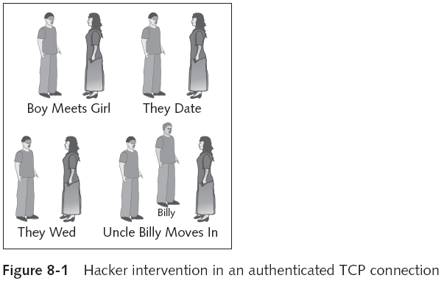
TCP Session Hijacking (continued)
Computer Security and Penetration Testing

Slide 6
Session Hijacking – Hacker’s Point of View
TCP works with IP to manage data packets
TCP tracks the packages sent to the receiver
One popular method of session hijacking is using source-routed IP packets
If source routing is turned off
  The hacker can use blind hijacking
  Guessing the responses of the two machines
Hacker can also be inline between B and C, using a sniffing program to follow the conversation
Computer Security and Penetration Testing

Slide 7
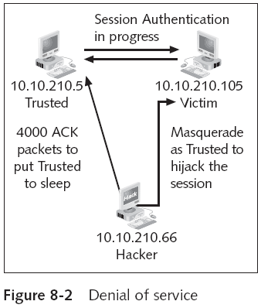
Session Hijacking – Hacker’s Point of View (continued)
Computer Security and Penetration Testing

Slide 8
Session Hijacking – Hacker’s Point of View (continued)
Hacker could find problems for two reasons:
  Host computer that has been hijacked will continue to send the packets to the recipient
  Recipient gives an ACK to the host computer after receiving packets from the hacker’s computer
Computer Security and Penetration Testing

Slide 9
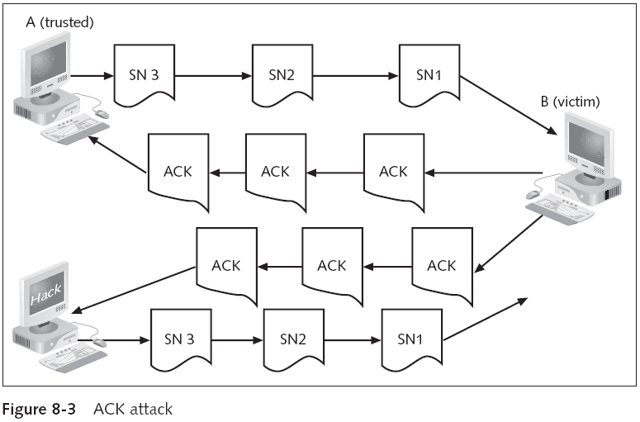
Session Hijacking – Hacker’s Point of View (continued)
Computer Security and Penetration Testing

Slide 10
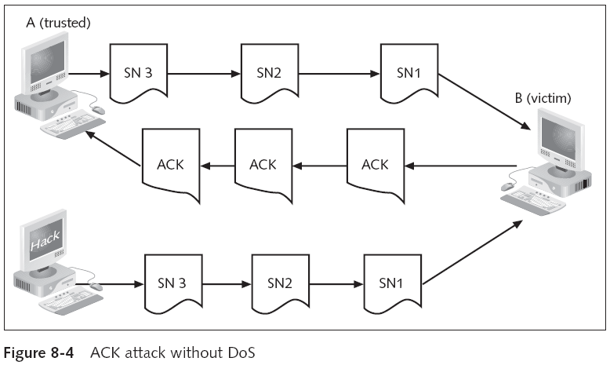
Session Hijacking – Hacker’s Point of View (continued)
Computer Security and Penetration Testing

Slide 11
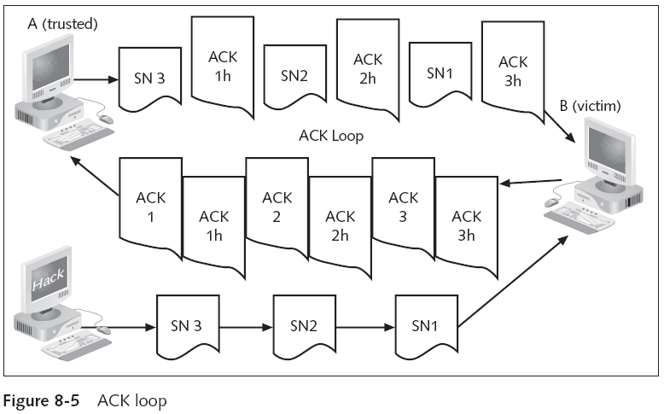
Session Hijacking – Hacker’s Point of View (continued)
Computer Security and Penetration Testing

Slide 12
Session Hijacking – Hacker’s Point of View (continued)
Continuous ACK Transfer
  Three ways to stop a continuous ACK transfer
    Losing the ACK packet
    Ending the connection
    Resynchronizing the client and server
Computer Security and Penetration Testing

Slide 13
TCP Session Hijacking with Packet Blocking
Packet blocking solves the ACK storm issue
  And facilitates TCP session hijacking
ACK storm happens because the attacker was not in a place to stop or delete packets sent by trusted computer
Attacker must be in control of the connection itself
  So that the session authentication takes place through the attacker’s chosen channel
Computer Security and Penetration Testing

Slide 14
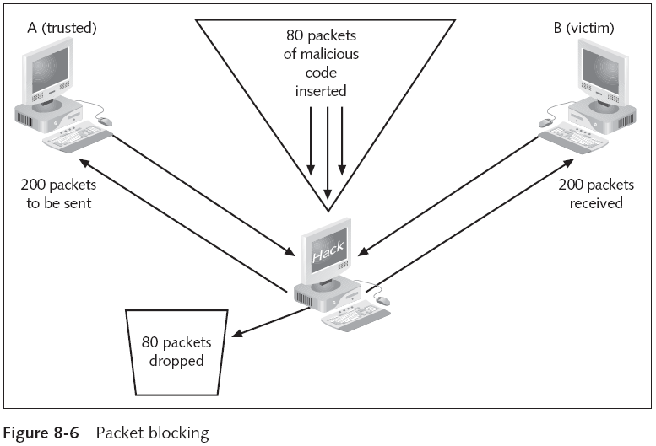
Computer Security and Penetration Testing

Slide 15
TCP Session Hijacking with Packet Blocking (continued)
Hacker can wait for the ACK packet to drop
  Or manually synchronize the server and client records by spoofing
If a hacker can block the packets
  Can drop exact number of packets desired for transfer
Computer Security and Penetration Testing

Slide 16
Methods
Route Table Modification
  All computers that use TCP/IP keep a route table
  A route table shows the way to the address sought
    Or way to nearest source that might know the address
  Route table has two sections
    Active routes and active connections
  If the route table can’t locate a perfect match of the IP address
    It searches for the closest possible match in the list of network addresses
Computer Security and Penetration Testing

Slide 17
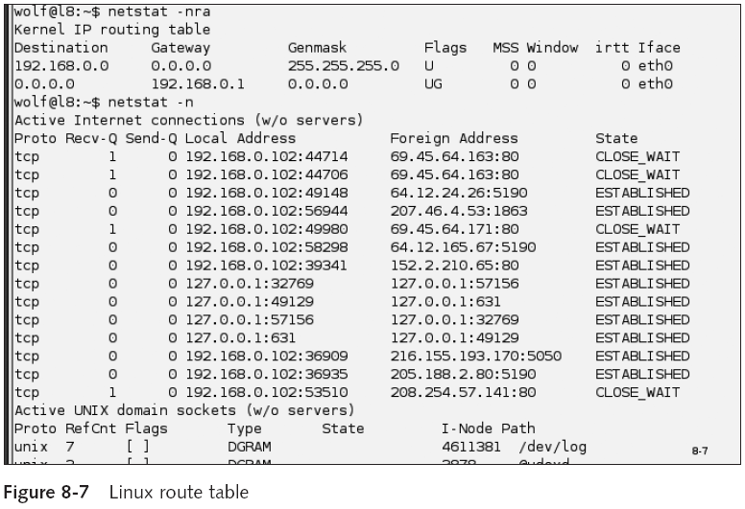
Computer Security and Penetration Testing

Slide 18
Methods (continued)
Route Table Modification (continued)
  After the match is found, the IP address of Computer A sends the packets to the IP address
  If the route table cannot find a match, it refers the request to the network gateway
  Active connections section shows the network addresses of the computers
    That are connected with the host computer
Computer Security and Penetration Testing

Slide 19
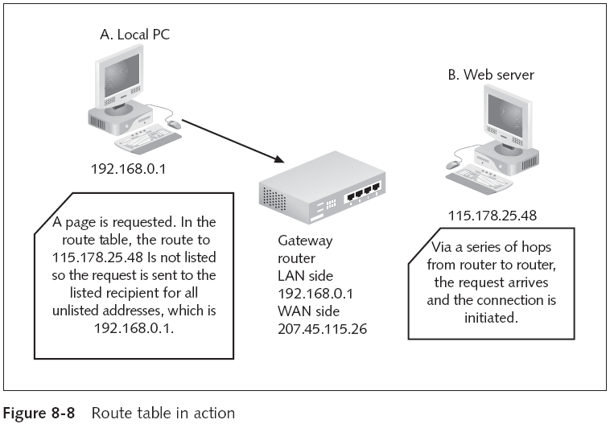
Computer Security and Penetration Testing

Slide 20
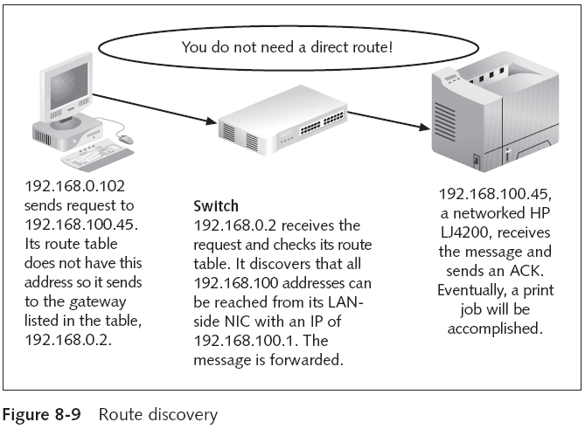
Computer Security and Penetration Testing

Slide 21
Methods (continued)
Route Table Modification (continued)
  Hacker changes the route table
  Host computer assumes that the best possible path for the transfer of data packets is through the hacker’s computer
Computer Security and Penetration Testing

Slide 22
Methods (continued)
Route Table Modification (continued)
  Hackers can modify a route table using two methods
    Erase all necessary records from the route table
      And then provide the hacker’s own IP address as the default gateway address
    Change the corresponding route in the route table of the gateway router
Computer Security and Penetration Testing

Slide 23
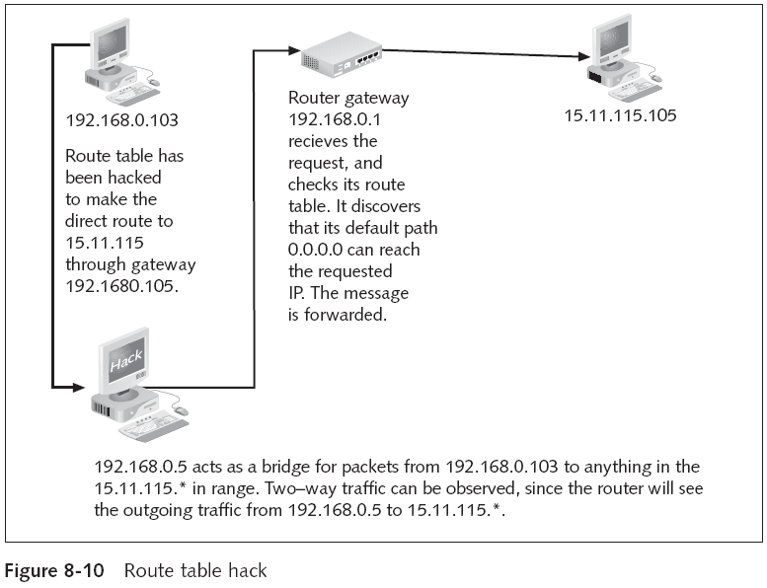
Computer Security and Penetration Testing

Slide 24
Methods (continued)
ARP Attacks
  Every computer has a unique IP address and a MAC, or physical address
  When a computer has to send data
    The host computer can find the MAC address of the destination computer by referring to the ARP table
  If MAC address is missing
    Host computer transmits a broadcast message called an ARP request
      To identify the destination computer’s MAC address
Computer Security and Penetration Testing

Slide 25
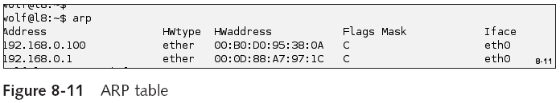
Methods (continued)
Computer Security and Penetration Testing

Slide 26
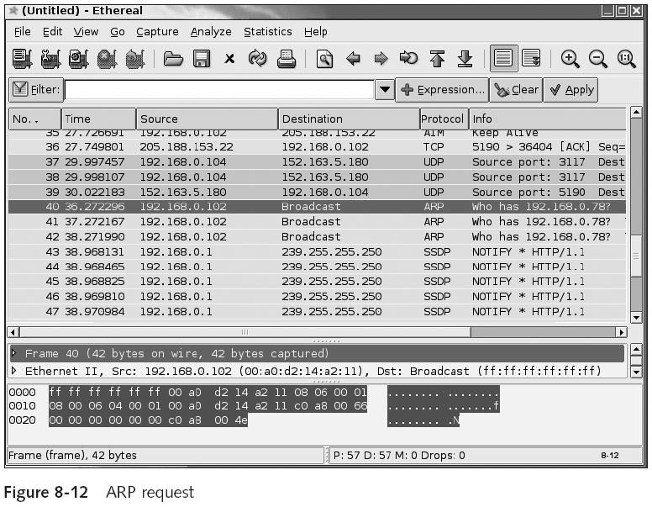
Computer Security and Penetration Testing

Slide 27
Methods (continued)
ARP Attacks (continued)
  Computer with an IP address that matches the request replies
    Creates fresh entry in the ARP table of host computer
  An attacker can interrupt the response from the destination computer
    And change its MAC address to the MAC address of the hacker’s computer
Computer Security and Penetration Testing

Slide 28
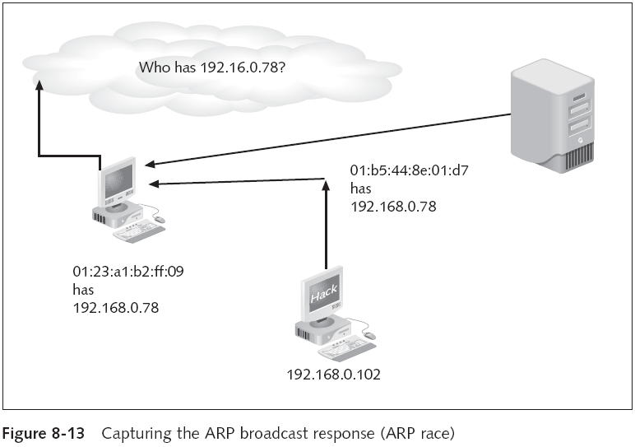
Computer Security and Penetration Testing

Slide 29
Session Hijacking Tools - Hunt
Developed by Pavel Krauz
  Inspired by Juggernaut
Performs sniffing and session hijacking
Menu options: listing, watching, and resetting connections
Hunt tool can hijack a session through ARP attacks
Computer Security and Penetration Testing

Slide 30
Hunt (continued)
Hunt allows hacker to synchronize the connection among the host and the server
  During session hijacking
Computer Security and Penetration Testing

Slide 31
UDP Hijacking
User Datagram Protocol (UDP)
  Connectionless protocol that runs on top of IP networks
UDP/IP provides very few error recovery services
  Offers direct way to send and receive datagrams over an IP network
  Used primarily for broadcasting messages
Computer Security and Penetration Testing

Slide 32
UDP Hijacking (continued)
More vulnerable to hijacking
  Hacker needs only to sniff the network for a UDP request for a Web site and drop a spoofed UDP packet in before the Web server responds
Computer Security and Penetration Testing

Slide 33
Prevention and Mitigation
To defend against session hacking, use encrypted protocols and practice storm watching
Computer Security and Penetration Testing

Slide 34
Encryption
Hacker needs to be authenticated on the network to be able to successfully hijack a session
If the data transfer is encrypted
  It is far too complicated and time consuming to get authenticated
Standard protocols like POP3, Telnet, IMAP, and SMTP are excellent targets
  Because they transfer data as plaintext
Computer Security and Penetration Testing

Slide 35
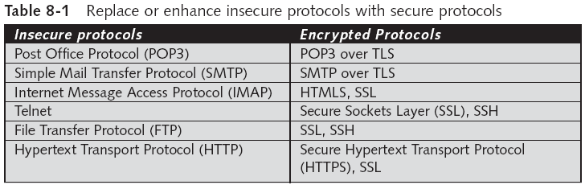
Encryption (continued)
Computer Security and Penetration Testing

Slide 36
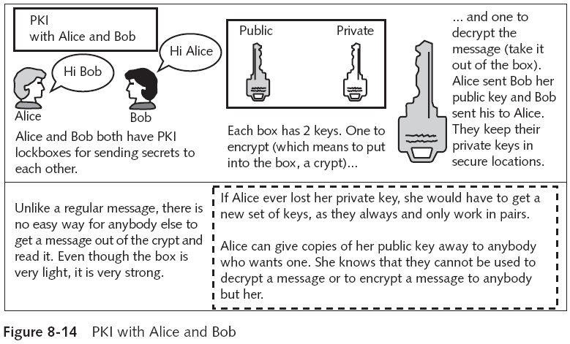
Encryption (continued)
Computer Security and Penetration Testing

Slide 37
Storm Watching
Refers to setting an IDS rule to watch for abnormal increases in network traffic
  And to alert the security officer when they occur
An unexpected increase in traffic could be evidence of an ACK storm
Packet size can be cached for a short period
  Two packets with the same header information but different sizes could be evidence of a hijacking in progress
Computer Security and Penetration Testing

Slide 38
Summary
TCP session hijacking takes place when a hacker takes control of a TCP session between two hosts
A successful hijacking takes place when a hacker intervenes in a conversation, takes the role of either host or recipient, and then receives packets before the actual host
Session hijacking can be accomplished by using source-routed IP packets, blind hijacking or a man-in-the-middle attack
Computer Security and Penetration Testing

Slide 39
Summary (continued)
Three ways of stopping a continuous ACK transfer: losing an ACK packet, ending the TCP connection, and resynchronizing the client and server
Packet blocking places the hacker in the actual flow of packets, solving the problem of the ACK transmission storm
TCP session hijacking with packet blocking can be performed in two ways:
  Modify route table
  Initiate an ARP attack
Computer Security and Penetration Testing

Slide 40
Summary (continued)
Hunt: popular tool used for session hijacking
UDP has a small number of error recovery features and is therefore more vulnerable to hijacking
Two methods to prevent session hijacking
  Encryption
  Storm watching
Computer Security and Penetration Testing

